Slide 1


PreDomS System
(Prediction of Domain from Sequence)
Group Members: Sualeha Khan, Anna Shahid
Supervisors: Sahar Fazal, Atif Jilani

Slide 2
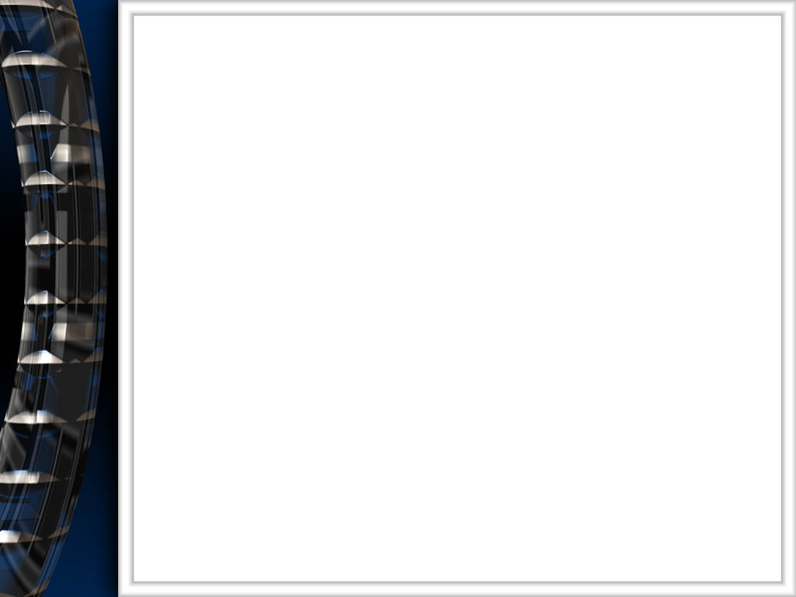
Contents
Introduction (Domains)
Predicting Domains
  By using 3D information
  By homology searching
PreDomS
PreDomS Features
Motivation
Methods
  Transcription and Translation
  Secondary Structure Prediction
  Domain Prediction
Artifacts

Slide 3
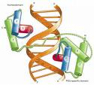
Domains
Protein domains are the basic unit of folding and function.
The function of protein depends upon the domain content in it and the order in which they are present.
Each domain has a separate function to perform for the protein .
They vary in length from between about 25 amino acids up to 500 amino acids in length.

Slide 4

Predicting Domains

Slide 5
By Using 3D Structural Information
Predicting domains is a task which is tricky and of vital importance.
Most of the existing domain prediction servers require structural information.
3D information for all the proteins (e.g. orphan proteins) is not always available in existing databases.

Slide 6
By Homology Searching
Some servers or tools use only amino acid sequence for prediction.
They require multiple alignment procedures against large databases. This method is also known as homology searching method.
In this case only such sequences can be regarded as domains:
  Either already identified sequences
  Or only those, which are maintained in the database as domains

Slide 7
PreDomS
Prediction of Domains from Sequence

Slide 8
PreDomS System is a computational toolkit, concerned specifically with proteins.
Performs operation like
  Transcription
  Translation
  Secondary Structure Prediction
  Domain Prediction
Provides the ease of domain prediction when only sequence data is available

Slide 9
No 3D structural information is required.
Domain prediction is made, based on
    Entropy profile of twenty amino acids

Slide 10
Motivation
Not all the proteins have structural information available for them
PreDomS serves as a single platform for some of the related operations
Methods for domain prediction from sequence are available but are based on multiple sequence alignment against large databases

Slide 11
PreDomS' Features

Slide 12
PreDomS handles three types of sequences
  cDNA
  mRNA
  AA
Transcription of cDNA sequence to yield mRNA sequence
Translation to yield AA sequence with freedom of cDNA or mRNA sequence as input
Prediction of secondary structure of protein from cDNA, mRNA or AA sequence

Slide 13
Domain prediction based on sequence only
Provides 2D output for
  Secondary Structure results
  Domain results
PreDomS maintains the records of
  Users
  Their performed operations
  Sequences

Slide 14
Methods

Slide 15
Transcription and Translation
Performed only on cDNA and mRNA sequence to ensure correct output.
Secondary Structure Prediction
Made according to Chou Fassman Algorithm.
All the three components of secondary structure i.e. Helices, Sheets and Turns are identified according to Chou Fassman parameters following algorithm steps.

Slide 16
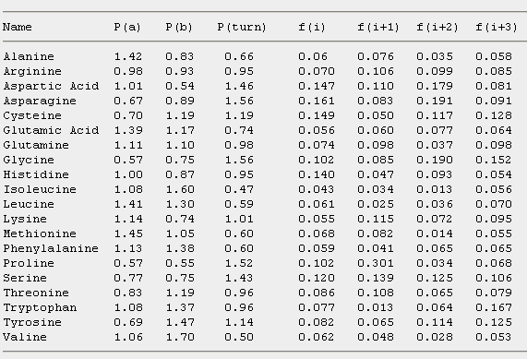
Chou-Fasman parameters

Slide 17
Chou-Fasman algorithm
Helix:
  Scan through the peptide and identify regions where 4 out of 6 contiguous residues have P(H) > 1.00. That region is declared an alpha-helix.
  Extend the helix in both directions until a set of four adjacent residues that have an average P(H) < 1.00 is reached. That is declared the end of the helix.
  If the segment defined by this procedure is longer than 5 residues and the average P(H) > P(E) for that segment, the segment can be assigned as a helix.
  Repeat this procedure to locate all of the helical regions in the sequence.

Slide 18
Initiation
Identify regions where 4/6 have a P(H) >1.00 “alpha-helix nucleus”
T
S
P
T
A
E
L
M
R
S
T
G
P(H)
69
77
57
69
142
151
121
145
98
77
69
57
T
S
P
T
A
E
L
M
R
S
T
G
P(H)
69
77
57
69
142
151
121
145
98
77
69
57

Slide 19
Propagation
Extend helix in both directions until a set of four residues have an average P(H) <1.00.
T
S
P
T
A
E
L
M
R
S
T
G
P(H)
69
77
57
69
142
151
121
145
98
77
69
57
If the average P(H) > P(E) for that segment,
the segment can be assigned as a helix.

Slide 20
Chou-Fasman algorithm
B-strand:
  Scan through the peptide and identify a region where 3 out of 5 of the residues have a value of P(E)>1.00. That region is declared as a beta-sheet.
  Extend the sheet in both directions until a set of four contiguous residues that have an average P(E) < 1.00 is reached. That is declared the end of the beta-sheet.
  Any segment of the region located by this procedure is assigned as a beta-sheet if the average P(E)>1.05 and the average P(E)>P(H) for that region.
  Any region containing overlapping alpha-helical and beta-sheet assignments are taken to be helical if the average P(H) > P(E) for that region. It is a beta sheet if the average P(E) > P(H) for that region.

Slide 21
Chou-Fasman algorithm
Turn
  To identify a bend at residue number j, calculate the following value
  p(t) = f(j)f(j+1)f(j+2)f(j+3)
  If
    (1) p(t) > 0.000075,
    (2) the average value for P(turn) > 1.00 in the tetrapeptide and
    (3) the averages for the tetrapeptide obey the inequality
    P(H) < P(turn) > P(E),
  then a beta-turn is predicted at that location.

Slide 22
Domain Prediction
Domain prediction is made based on latent entropy profile of amino acids in the sequence.
Degrees of freedom for Φ , ψ, and χ angles are given.
A window size is selected and window is slided along the sequence.
Entropy profile is calculated based on the average number of degrees of freedom.

Slide 23
The propensity for each residue inside the window is then averaged and assigned to the central amino acid.
Minima in the entropy profile correlate with domain boundaries.

Slide 24
Tools

Slide 25
Language: Java
Front End Tool: Netbeans
Database: MySQL

Slide 26

Functional Requirements

Slide 27
Use Case Diagram

Slide 28
Traceability Matrix

Slide 29
Domain Model

Slide 34
Thank You

